Slide 1
Local Interconnect Network (LIN)
Syed Rafsan Ishtiaque
Muhammad Rohail Usman
Yigitcan Aydin

Slide 2
Background
LIN, Local Interconnect Network, that tries to provide
everything that we need to build a simple, low-cost bus
tailored to the needs of the automotive and other industry/ applications.
LIN is widely popular and present in many vehicle platforms, with
the usage of 20+ LIN nodes per vehicle is not an exception.

Slide 3
Reason for selecting LIN
Aim: cost efficiency, small sensor, actuators, and control networks. It is widely used where bandwidth is not the main criteria rather low-cost and accessibility
We can run LIN on very low-cost ECUs. Theoretically, even without a quartz clock but only with an RC element
The architecture is a master-slave setup with up to 16 nodes, one master and
up to 15 slave nodes.

Slide 4
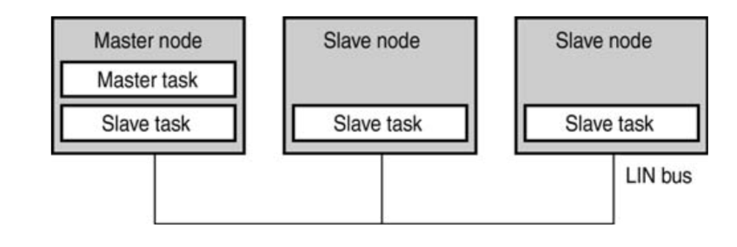
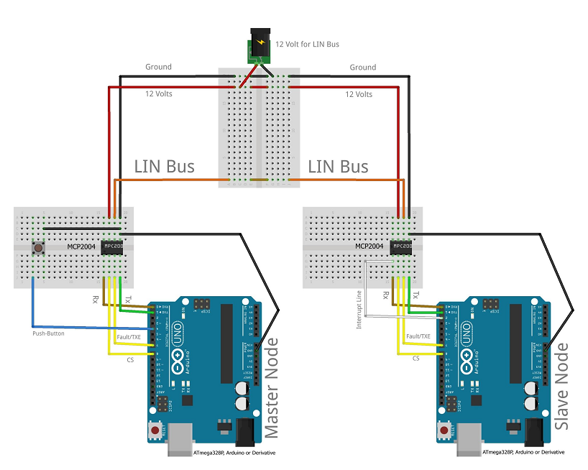
Comparison with our project

Slide 5
Where to implement our project in real life scenario
Car radio, air conditioning, window functionalities, mirrors, doors, lights,
interior, remote controlling of the car’s radio and so on
LIN is targeted at vehicle body controller
Even we can use it in any project where communication is necessary, such as our advanced embedded lab project

Slide 6
LIN vs UART (Universal Asynchronous Receiver-Transmitter)
Connecting 16 participants requires one wire plus power related cabling for LIN because it is a shared medium.
While in UART, connecting point-to-point 16 devices over a UART could easily become its own management challenge and certainly will need 240 connections without counting for the power related cabling, 120 connections for transmission and same for reception.

Slide 7
Resolving communication collision
If there are multiple people in group call and everyone speaks simultaneously then no one will clearly be able to listen each other.
In LIN nomination of one master like managing the group call. The master acts as a conductor. Based on a defined arrangement our schedule table, the master requests each individual communication participant to speak up.
Now everyone can listen to the information and speak up if there is a turn agreed in advance, this is how LIN resolves any communication collisions.

Slide 8
Master and Slave node
The master task is a routine that is only contained in
the LIN master node. Its job is to read the schedule
table entries and call out all the slave nodes in defined order.
The slave task despite its name, resides in all nodes
also the master node. Its job is to listen to the bus for a header
message and react accordingly depending on the identifier

Slide 9
Baud Rate
The baud rate is the rate at which information is transferred in a communication channel.
Baud rate is commonly used when discussing electronics that use serial communication.
In the serial port context, "9600 baud" means that the serial port is capable of transferring a maximum of 9600 bits per second

Slide 10
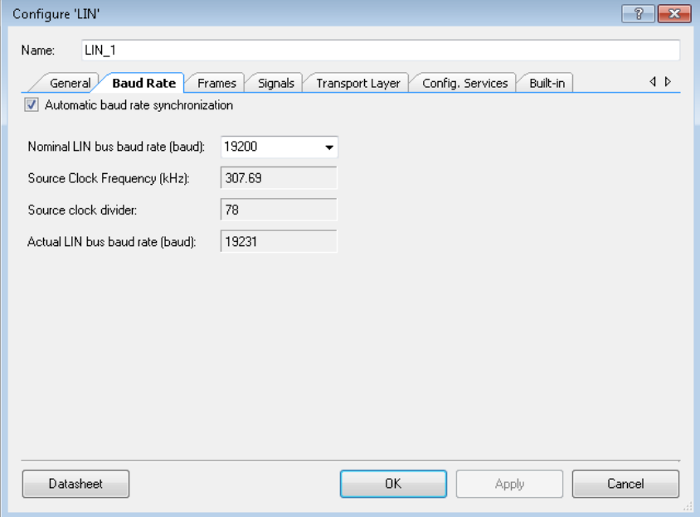
Automatic Baud Rate Synchronization
This option enables the component measures the exact baud rate of the bus from the sync byte field of each LIN frame header.
Example: Max 20k, Min 1k, when ABRS on, the actual BR can be between 20k and 1k

Slide 11
LIN Frame
A LIN frame consists of header and response parts
Master node sends messages to the slaves using header part of the frames
Slave nodes responds the requests from master node using response part of the frame. This response message contains up to 8 bytes of data

Slide 12
LIN Frame: Header
Break (or SBF, Sync Break Field): min 14 bits long but usually it is 20 bits long in use. This field is considered as the start of the frame
Sync field: Contains 8 bits to determine the baud rate of the master node. This field helps to synchronize all the slave nodes
Identifier (or ID field): Contains 6 bits (64 IDs) which determines which slave nodes must respond to the header. As a plus it contains 2 parity bits that helps slaves to validate the messages

Slide 13
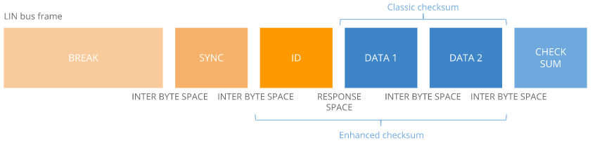
LIN Frame: Response
Data field: Data field contains the information to be responded to the master. May transmit 2, 4 or 8 bytes of data
Checksum field: Contains 8 bits to validate LIN frame. Validation is done by summing up the data bytes. In enhanced checksum, bits in the data field and ID field are summed up to get the validation
[1]

Slide 14
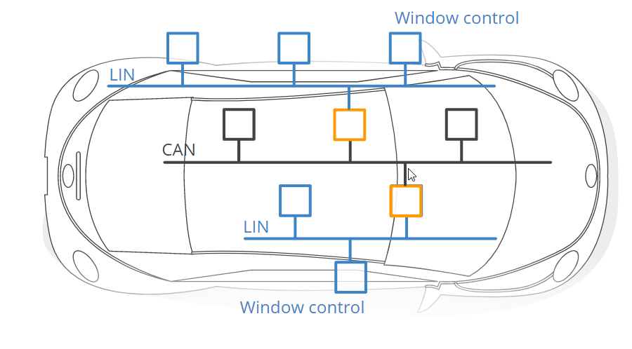
LIN and CAN
[1]

Slide 15
LIN Usage
In automotive industry:
Window
Engine
Door
Seats
Wipers

Slide 16
Hands on approach
Implementation of a Simple Hello World in LIN Network.
With the Master Node in charge, LIN frames are exchange within scheduled slots and Frame Identifer 0x30

Slide 17
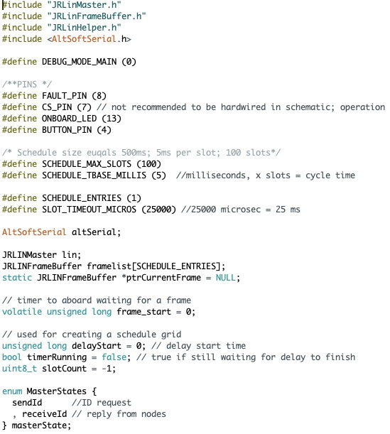
Software Workflow - Master Node:
Master Node Scheduler

Slide 18
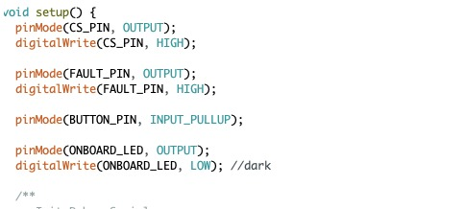
Master Node I/O PIN and Memory Allocation

Slide 19
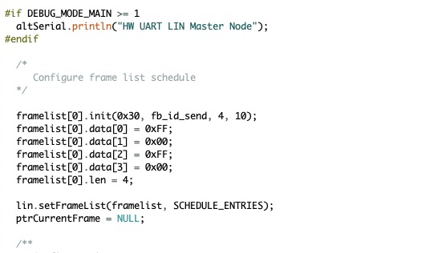
Master Node LIN Frames

Slide 20
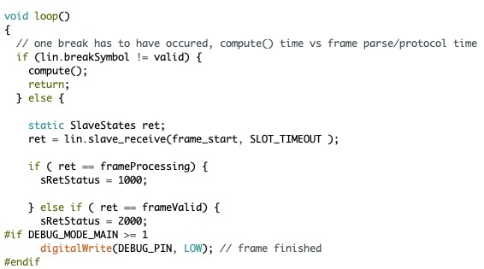
Software Workflow - Slave Node:
Slave Node Scheduler

Slide 21
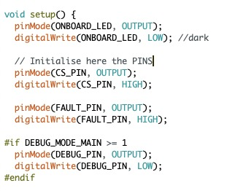
Slave Node I/O PIN and Memory Allocation

Slide 22
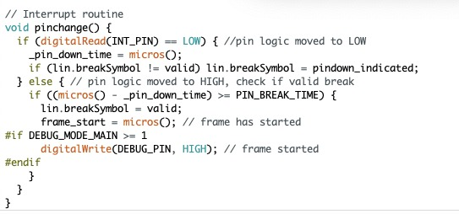
Slave Node Break Symbol Identifier

Slide 23
Thanks For Your Attention

Slide 24
Reference
[1] CSS Electronics, LIN Bus Explained - A Simple Intro (2022), https://www.csselectronics.com/pages/lin-bus-protocol-intro-basics, Accessed on 01.06.2022
[2] Everything is Uploaded to the GitHub : https://github.com/EhamRafsan/Local-Interconnect-Network-LIN

